Slide 1

S3 Case Study Project
Group 10: Francisco Marcó
Kaloyan Andreev
Sava Vasilev
A flight management infrastructure solution

Slide 2


Agenda
Recap
Web application
Infrastructure components
Testing
Demo
Work Reflection
MDP
Conclusion

Slide 3
Recap

Slide 4


Our solution
IaaS to provide infrastructure to flight agencies
Allow bookings, scheduling, flight management
Manage payments and user information
Provide an easy, accessible experience to travelers and tourists

Slide 5




User Requirements Specifications
Simplify and speed up internal operations for a more efficient pipeline
Ensure customer success experience with CS tools
Save up money and time
Secure Cloud based environment

Slide 6
Our web application

Slide 7
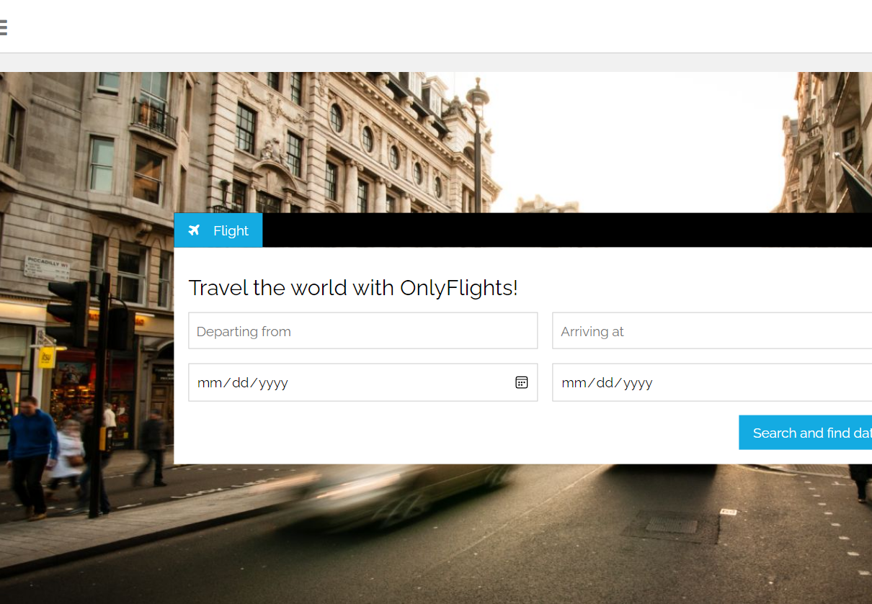
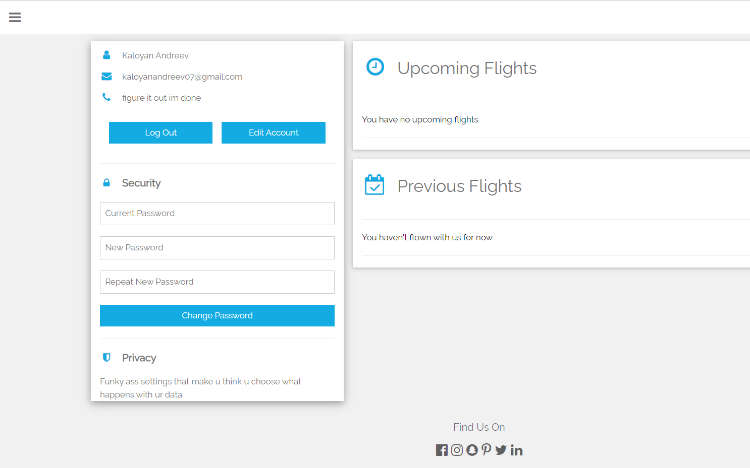
OnlyFlights webpage
Features
Account creation
Real-time flight information using API
Ticket booking
Account management
Booking history
Contact maintainers in case of not working function

Slide 8

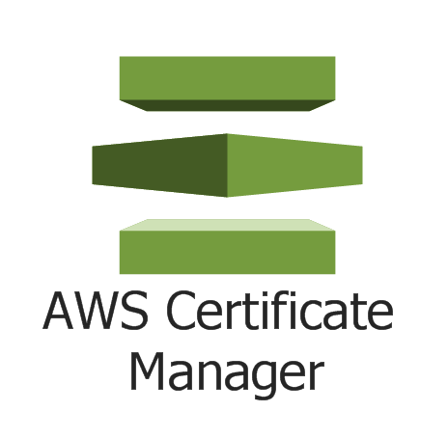
OnlyFlights webpage
Technical Details
Hosted on ECS Fargate instance
Implementation of Application Load Balancer to regulate the traffic
High-availability
Secure connection by using HTTPS protocol
CI/CD Pipeline implemented
AutoScaling available

Slide 9
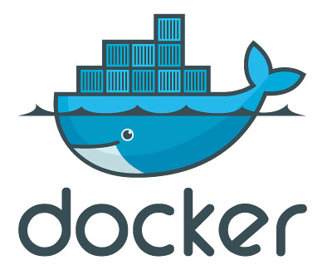

CI/CD Pipelines
Way of working
GitLab CI/CD pipelines implemented to AWS ECS
Image is pushed to ECR repository
GitLab Runner tests the webapp by performing few tests and creating a Docker image
New Fargate tasks are deployed

Slide 10
Infrastructure Architecture

Slide 11



Virtual Machines
EC2 Instances
Admin
GitLab Runner
OpenVPN
Prometheus + Grafana
Manages OnlyFlights Database instance
Tests the new webapp versions before deploying to ECS
Connect AWS to InfraLab

Slide 12
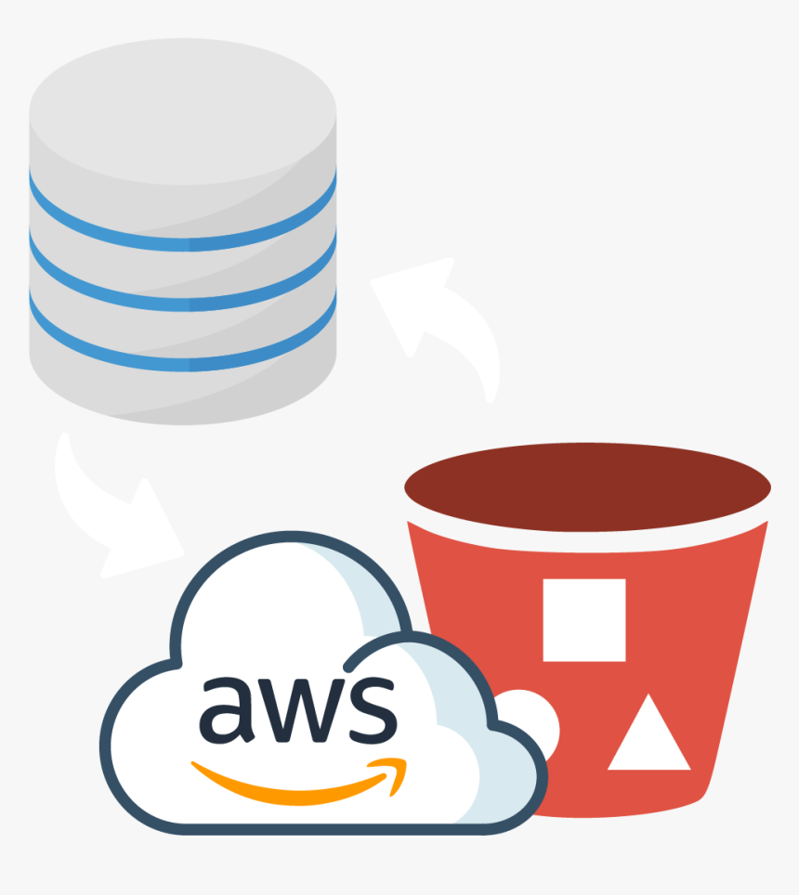
Used storages
Details
MySQL RDS instance
Stores the data about the webapp users, all flights, luggage etc.
S3 Buckets
Keeps the flow logs from each subnet
Stores a static website in case of failover of the ECS Service

Slide 13


Routing and certificates
Route53
Request AWS Domain
Configure hosted zone records
SSL Certificate
Needed for using of HTTPS protocol with the website
Services

Slide 14
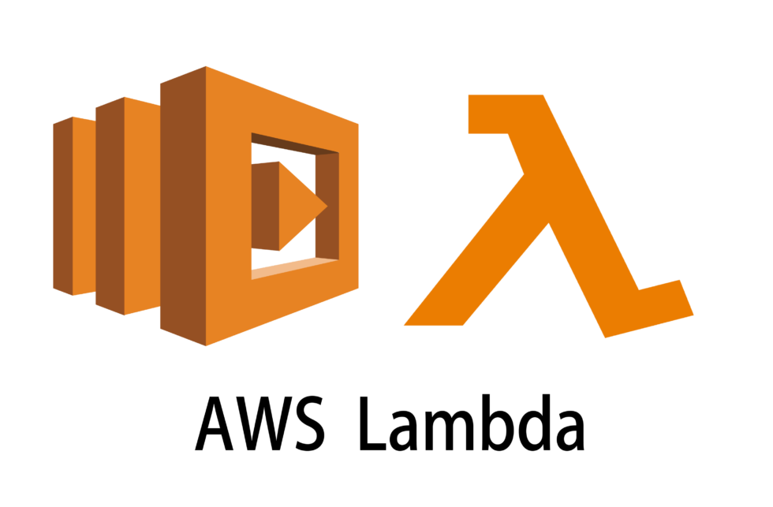
Serverless functions
Lambda
Turn on/off EC2 instances based on EventBridge Schedule
Create RDS snapshots daily at specifically set timetable

Slide 15
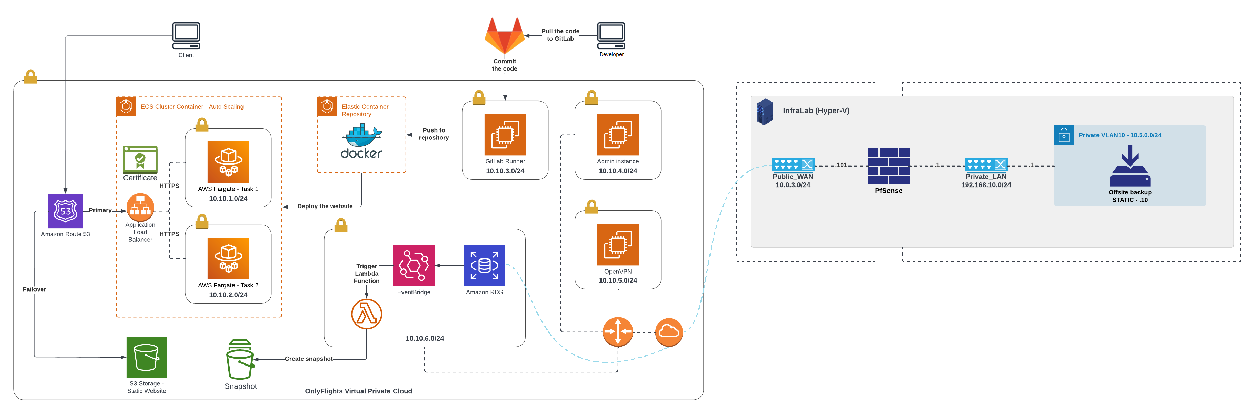
Cloud environment

Slide 16
Testing

Slide 17
Aspects to test
INFRASTRUCTURE
Website
security

Slide 18
Scope
Infrastructure
Infrastructure & its components are functional and cost efficient
Website
Webapp is functional and accessible
Security
Secrets Management, Networking
Security measures (hash passwords, store data, authentication.)

Slide 19

Testing results
Infrastructure
Proper EC2 functioning and management ✅
ECR + ECS ✅
CI/CD ✅
Load Balancer ✅
RDS ✅
IaC (Terraform, Ansible, Shell) ✅
Lambda ✅
Monitoring ✅
Route53 ✅

Slide 20

Testing results
Web application
Website ✅
User management and authentication ✅
API integration with airport data ✅
Stress test ✅
Python application that runs TF scrips on AWS ✅

Slide 21

Testing results
Security
Key Management ❌
DB Secrets management ✅
Networking configuration✅
Security Groups ✅
Backups✅

Slide 22
Demo

Slide 23
Work Reflection

Slide 24
Achievements
Cloud environment
Infrastructure As code
monitoring
backup

Slide 25
Multi-disciplinary project

Slide 26
Chosen project - IQADOT
Knowledge base for business and education primarily
Based on providing a singular answer to a question in a channel based (slack, discord) format
Client: Ali Odac
Tutor: Mikaeil Shaghelani

Slide 27
Final MVP Release
CI/CD Pipelines
Elastic Beanstalk Deployment
SQL database
NGINX webserver
IQADOT Admin & Public instance
GitLab Repository
Pushes code into ECR

Slide 28

Elastic Beanstalk deployment
Features
Web-application Management
Deployment
Elasticity
Monitoring
Security
Versioning
Logging

Slide 29
Teamwork and Leadership
Difficult to handle workload and client expectations
Unclear and uncertain start, took a while to understand the scope
Difficult engaging with groupmates (💀)

Slide 30
Network architecture

Slide 31
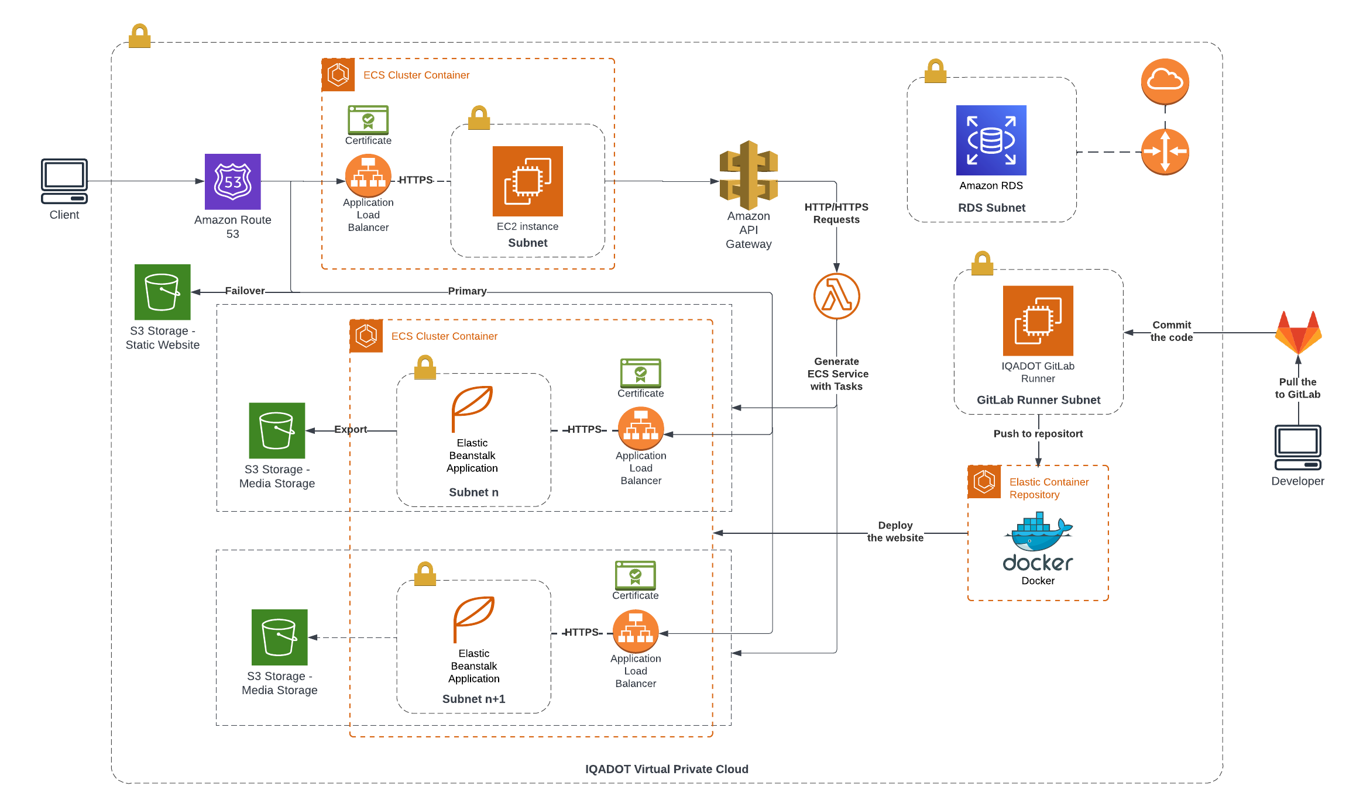

Slide 32
Conclusion

